Slide 1
Advertising, Fictitious Goals, and Adler's Love Task
Grace K. Jacobson and Brock J. Schludecker
Adler School of Professional Psychology
NASAP Annual Conference, May 2014

Slide 2
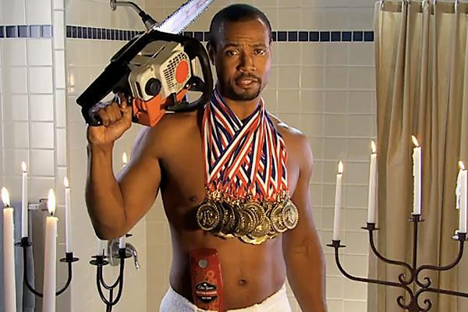
Facets of the Love/ Sex Task
“What is my sexual self-ideal?”
Most difficult of the life tasks; requires the most interpersonal cooperation:¹¹
Sexual role definition: What does it mean to be a man/ woman?
Sexual role identification: How do I measure up to this definition?
Sexual behavior: What is appropriate sexual behavior?

Slide 3
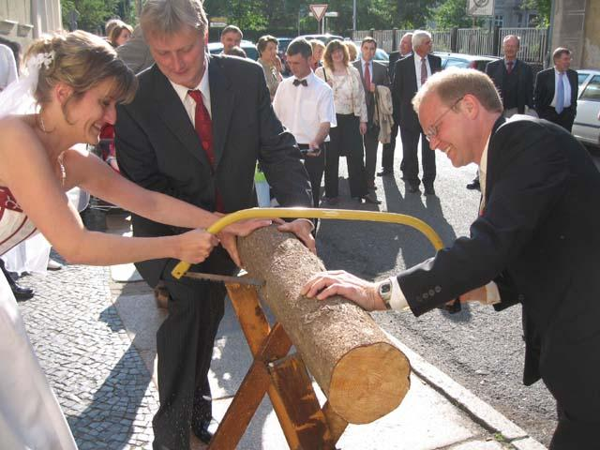
Success in the Love Task
“Cooperation is the chief prerequisite for marriage.” - Alfred Adler ²
Includes intimacy, love, marriage and sex.
The ability to be a good partner is a direct reflection of one’s social interest.
Love is “the effort to ease and enrich the other’s life”¹
The Dyad of perfect love
Zweisamkeit - “Twosomeness”⁴
“If we contemplate an escape, we do not collect all our powers for the task” - Alfred Adler²
“...A hypercompetitive society can foster a faulty style of personality development, where the exaggerated striving for superiority impairs or halts the process whereby an individual could learn the courage to love.” - Eiriek, 2001⁶

Slide 4
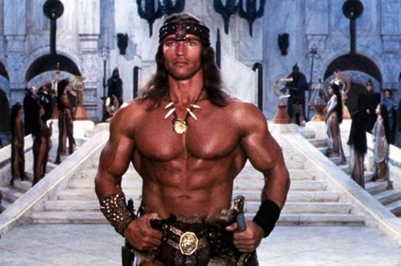
Advertising’s Effect on the Sexual Self-Ideal
“People have a natural drive to evaluate their own attributes and abilities, which they do by comparing themselves with others” - Leon Festinger, 1954⁷
Men exposed to muscular-ideal commercials had lower muscle satisfaction and self-rated physical attractiveness. This was most prevalent for men who were appearance-oriented.⁹
Women viewing moderately thin models can actually assimilate, resulting in higher self esteem than when looking at moderately heavy models. But when the models are extremely thin, women have lower self-esteem than when they view extremely heavy women.^{12, 13}

Slide 5
Advertising’s Effect on Relational Sexual Ideals
Research finds that...
People who view pictures of attractive people feel less attractive, less attracted to their current partners, and less satisfied with their sexual lives.⁷
Ads with sexual content affect men and women differently because men and women think about sex differently:
MEN
Men think about sex a LOT and fantasize about sex with multiple women.¹⁰
Men believe and want to see sexualized ads (ESPECIALLY if they feel insecure).¹⁰
WOMEN
Women associate sex with feelings of intimacy and relationship.⁵
Women don’t identify with most overtly sexual ads. They like romantic ads that suggest commitment. ⁵

Slide 6
Examples (females)

Slide 7
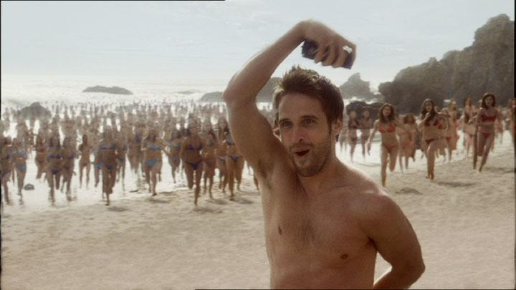
Examples (male)

Slide 8
Conclusions
Contemporary ads reflect that difference in sexual ideal between genders which had actually already been instilled through socialization.
Therefore, ads tend to REFLECT our own values back to us and say “You know that this is what success looks like. If you buy our product, you too can be successful and achieve love/sex.”
Research suggests that ads don’t change people’s values. People tend to buy products in line with their own self-concepts and values. ⁸
Looking at ads could make us feel further from the sexual ideal (both intrapersonally and interpersonally), which might motivate us to buy a product to better meet that ideal.
OR
We didn’t need ads to compare to in the first place, and we are already socialized to compare ourselves to others.
How might these implications be different if more people were striving horizontally, rather than vertically?

Slide 9
Recommendations & References
Future research should take into account:
The wide variety of types of media to examine: print, TV, film, social media, pornography.
Media targets different age groups based on cultural expectations around sex for that age (e.g. different messages to teens vs adults).
Cultural differences that might not value “Western” ideas of sex and love.
Are people socialized differently in recent years due to the rising ability to constantly access media?
1. Adler, A., Ansbacher, H. L., & Ansbacher, R. R. (1958). The Individual psychology of Alfred Adler. Lond.: Allen & Unwin. 2. Adler, A., Ansbacher, H. L., & Ansbacher, R. R. (1978). Co-operation between the sexes: writings on women, love and marriage, sexuality, and its disorders. Garden City, N.Y.: Anchor Books. 3. Adler, A. (1971). Love is a recent invention. Journal of Individual Psychology, 27, 144-152. (Original work published 1936). 4. Adler, A., & Stein, H. (2006). The general system of individual psychology: overview and summary of classical Adlerian theory & current practice. Bellingham, WA: Classical Adlerian Translation Project. 5. Dahl, D. W., Sengupta, J., & Vohs, K. D. (2009). Sex in advertising: Gender differences and the role of relationship commitment. Journal of Consumer Research, 36, 215-231. 6. Eirik, S. (2001). The courage to love: Social interest and sexuo-morphological meaning. Journal of Individual Psychology, 57(2), 158 - 172.
7. Galician, M. (2004). Sex, love, and romance in the mass media: Analysis and criticism of unrealistic portrayals and their influence. Mahwah, NJ: Lawrence Erlbaum Associates.
8. Grohmann, B. (2009). Gender dimensions of brand personality. Journal of Marketing Research, 46 (1), 105-119.
9. Hargreaves, D. A., & Tiggemann, M. (2009). Muscular ideal media images and men’s body image: Social comparison processing and individual vulnerability. Psychology of Men and Masculinity, 10 (2), 109-119.
10. Lindstrom, M. (2011). Brandwashed: Tricks companies use to manipulate our minds and persuade us to buy. New York, NY: Crown Business.
11. Mosak, H. H., & Maniacci, M. (1999). A primer of Adlerian psychology: the analytic-behavioral-cognitive psychology of Alfred Adler. Philadelphia, PA: Brunner/Mazel.
12. Smeesters, D., & Mandel, N. (2006). Positive and negative media image effects on the self. Journal of Consumer Research, 32, 576-582.
13. Wan, F., Ansons, T. L., Chattopadhyay, A., & Leboe, J. P. (2013). Defensive reactions to slim female images in advertising: The moderating role of mode of exposure. Organizational Behavior and Human Decision Processes, 120 (1), 37-46.

